Slide 1
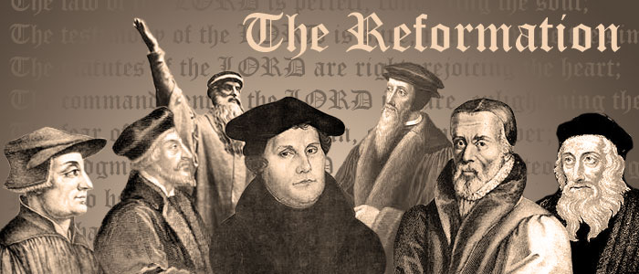
A long, long time ago
We must all remember
How the Reformation got its start.

Slide 2
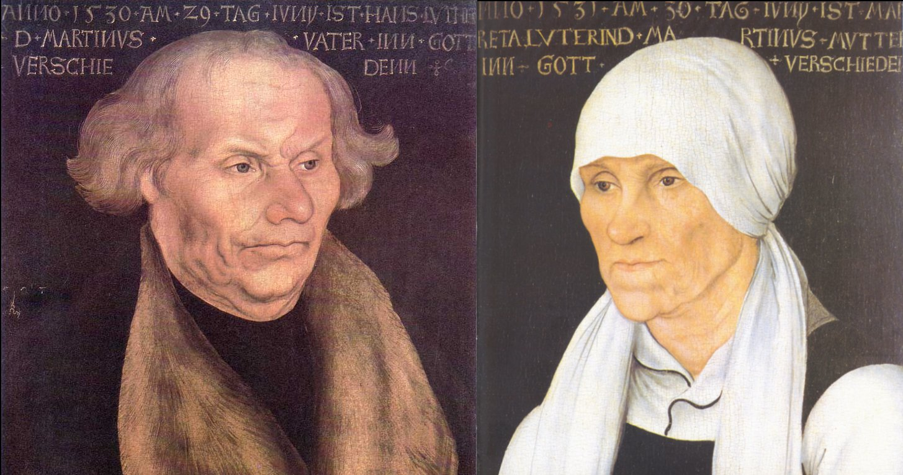
A boy to Hans and Margaret born
Was baptized on the following morn,
The child of the Luthers was named Mart.

Slide 3
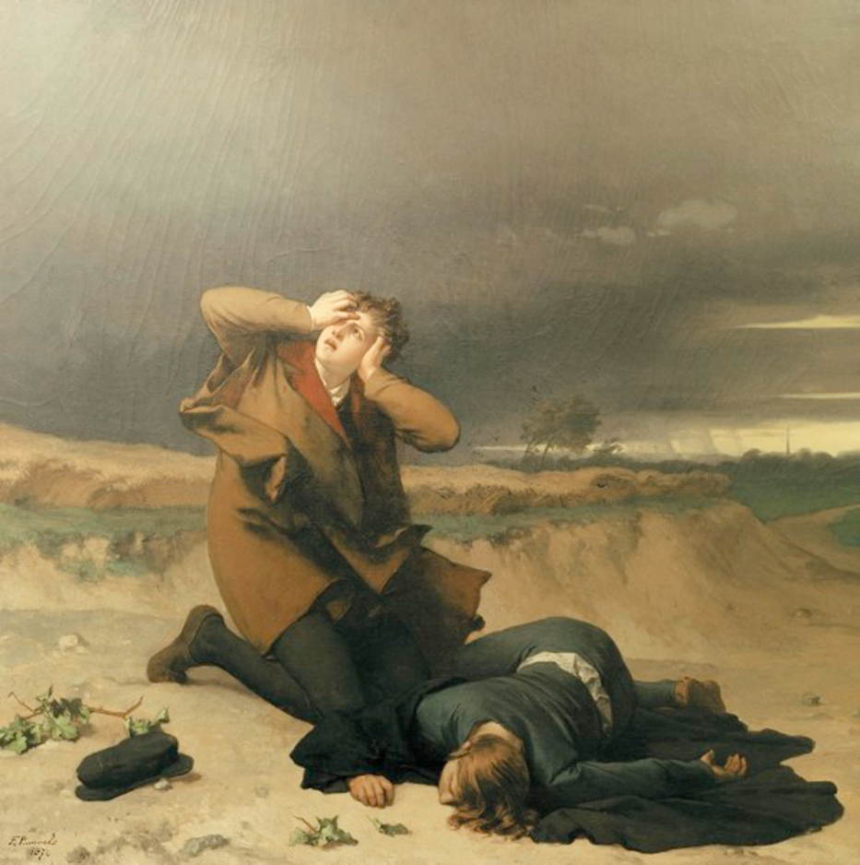
Young Martin Luther got the call
When a lightning bolt caused him to fall.

Slide 4
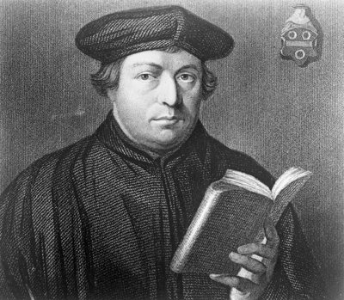
He sold his books for law school
And took up studying God’s rule.

Slide 5
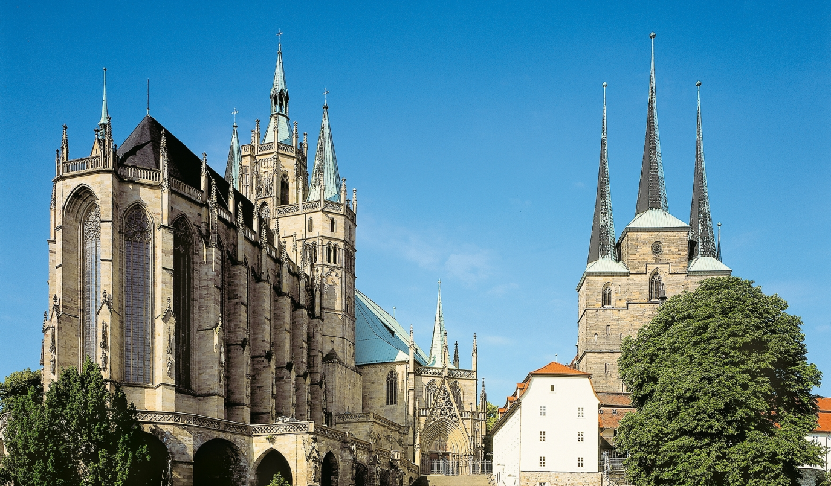
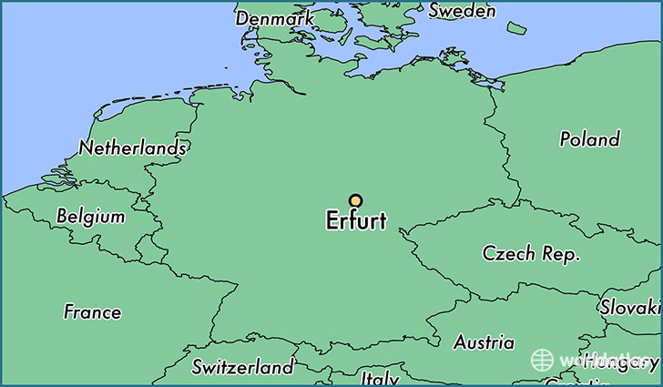
He entered the
monastic life
In the peaceful
Erfurt countryside
And something
touched him deep inside
The day he took
those vows.

Slide 6
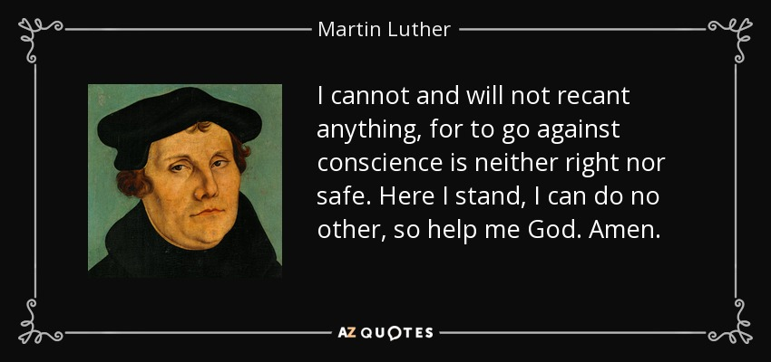
My, my this here Lutheran guy
May be famous, but he’s dangerous
And a thorn in our side
Them good old boys at the Vatican cried,
Saying, “Just recant or you will be tried!”
He said, “Here I stand,
I won’t be denied!”

Slide 7
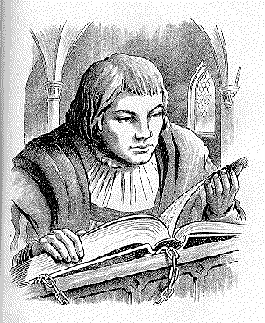
He started on his quest with love
And the utmost faith in God above
He let the Bible be his guide.

Slide 8
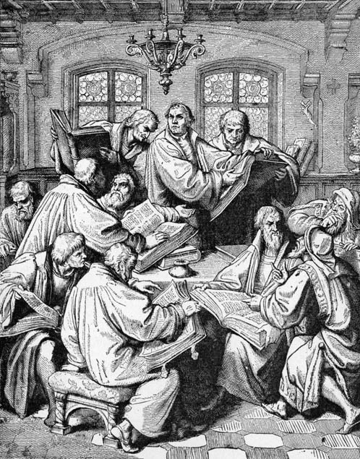
But he stood up to
the monks who told
That works could
save your mortal soul
And tried to teach,
“By grace we’re
justified.”

Slide 9
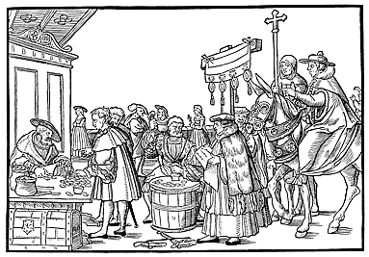
Well he said John Tetzel was a crook
Because of the indulgences he took.
Then late one Halloween night,
He gave the Vatican a fright.
“As soon as the coin in the coffer rings,
The soul from purgatory springs.”

Slide 10
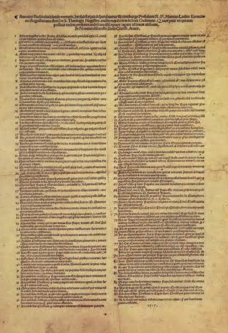
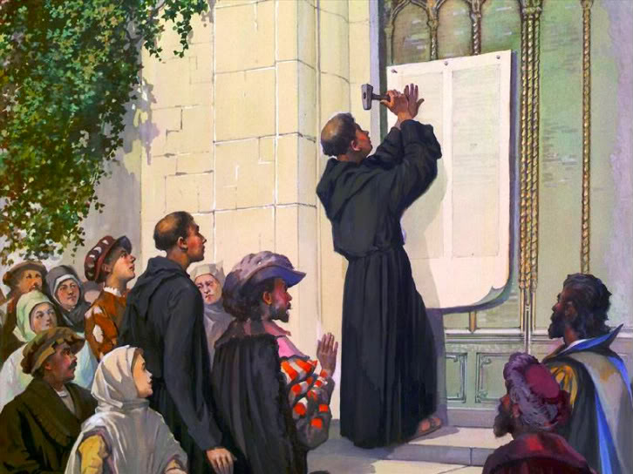
He nailed his Ninety-Five Theses to the door,
Never meant to start a holy war,
But this is what he was called for
The day he took those vows.

Slide 11
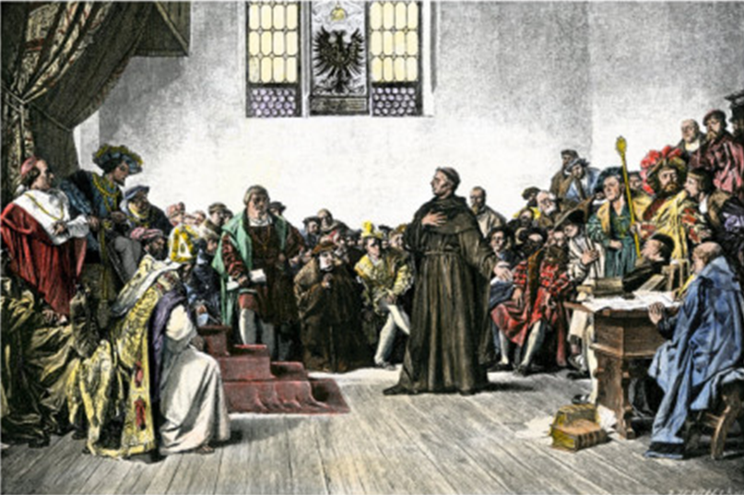
My, my this here Lutheran guy
May be famous, but he’s dangerous
And a thorn in our side
Them good old boys at the Vatican cried,
Saying, “Just recant or you will be tried!”
He said, “Here I stand, I won’t be denied!”
Archbishop Albert with the Pope
And Cardinal Cajetan all spoke
‘bout Martin Luther’s heresy
So they called him back to Rome to see
If a Diet of Worms could ever be
Enough to make him stop his blasphemy
He was ex-communicated then
By a jury of his former friends
The courtroom was adjourned
The verdict was returned
And while Martin left that day from Rome
To Castle Wartburg, his new home
He recalled the fervor he had known
The day he took those vows
My, my this here Lutheran guy
May be famous, but he’s dangerous
And a thorn in our side
Them good old boys at the Vatican cried,
Saying, “Just recant or you will be tried”
He said, “Here I stand, I won’t be denied”
He met a girl who’d been a nun
And escaped the convent on the run
Katharina Bora was her name
In Wittenberg as man and wife
Mart ’n’ Katy started their new life
And pretty soon six new Lutherans came along
Now the printing press was all the rage
And Martin’s words were on each page
The Word was also spoken
For the rules had all been broken
And the three that he admired the most
The Father, Son and the Holy Ghost
Were praised with an angelic host
The day he took those vows
My, my this here Lutheran guy
May be famous, but he’s dangerous
And a thorn in our side
Them good old boys at the Vatican cried,
Saying, “Just recant or you will be tried”
He said, “Here I stand, I won’t be denied”
They were singing, My, my this here Lutheran guy
May be famous, but he’s dangerous
And a thorn in our side
Them good old boys at the Vatican cried,
He said, “Here I stand, I won’t be denied”

Slide 12
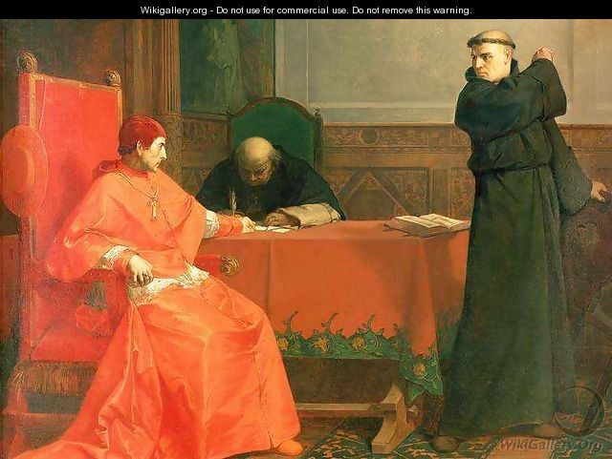
Archbishop Albert with the Pope
And Cardinal Cajetan all spoke
‘bout Martin Luther’s heresy.

Slide 13
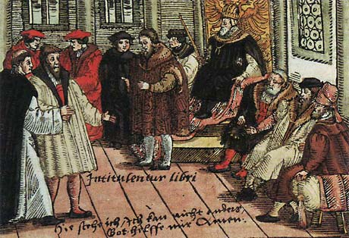
So they called him back to Rome to see
If a Diet of Worms could ever be
Enough to make him stop his blasphemy.

Slide 14
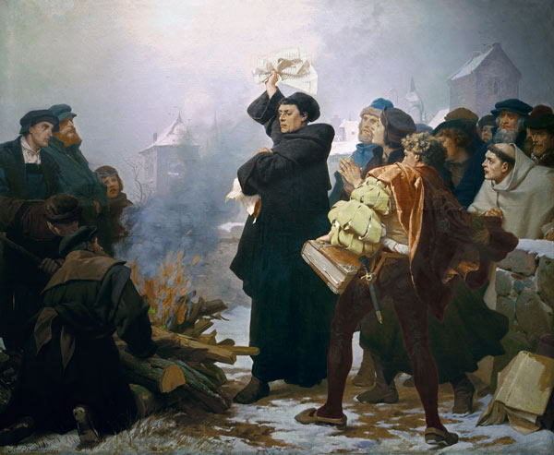
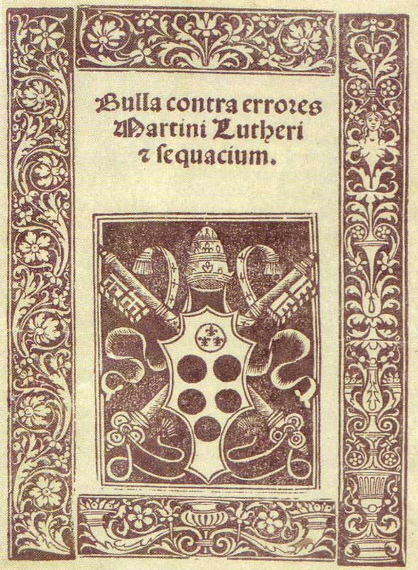
He was ex-communicated then
By a jury of his former friends.
The courtroom was adjourned—
The verdict was returned.

Slide 15
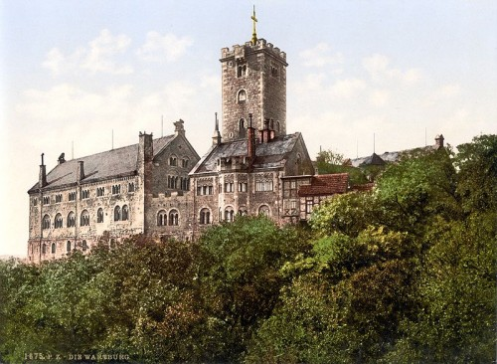
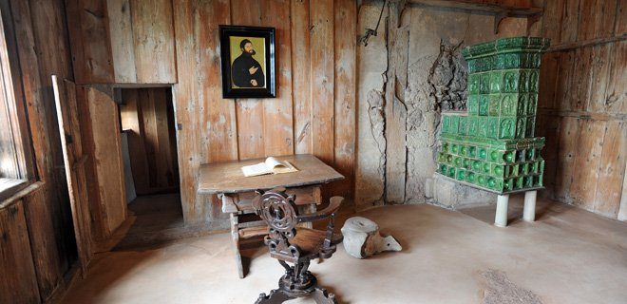
And while Martin left that day from Rome
To Castle Wartburg, his new home,
He recalled the fervor he had known
The day he took those vows.

Slide 16
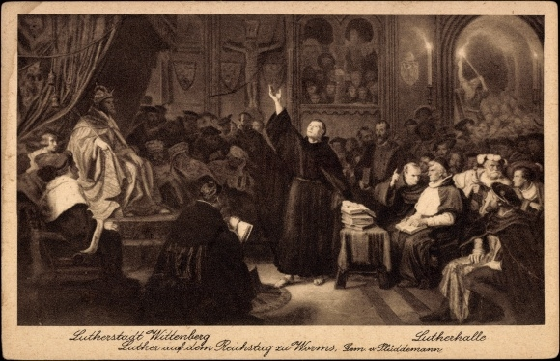
My, my this here Lutheran guy
May be famous, but he’s dangerous
And a thorn in our side.
Them good old boys at the Vatican cried,
Saying, “Just recant or you will be tried!”
He said, “Here I stand, I won’t be denied!”

Slide 17
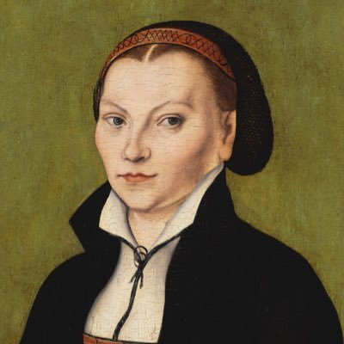
He met a girl who’d been a nun
And escaped the convent on the run—
Katharina von Bora was her name.

Slide 18
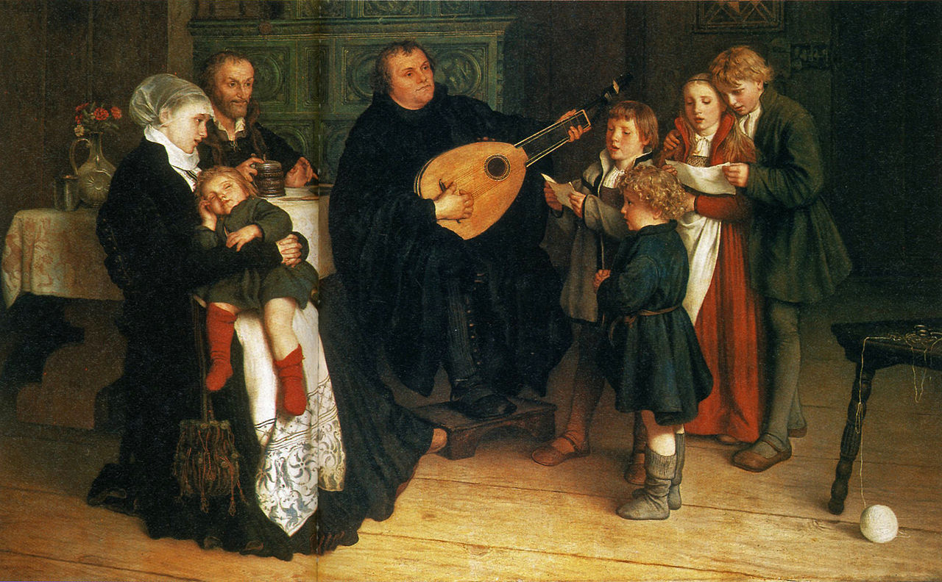
In Wittenberg as man and wife,
Mart ’n’ Katy started their new life,
And pretty soon six new Lutherans came along.

Slide 19
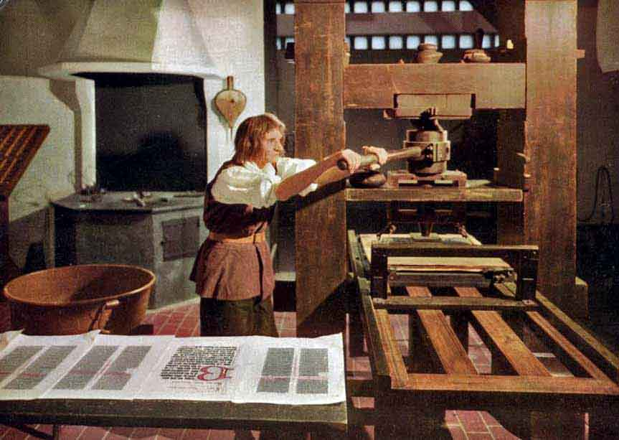
Now the printing press was all the rage
And Martin’s words were on each page.
The Word was also spoken
For the rules had all been broken.

Slide 20
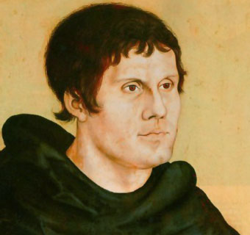
And the three that he admired the most—
The Father, Son and the Holy Ghost—
Were praised with an angelic host
The day he took those vows.

Slide 21
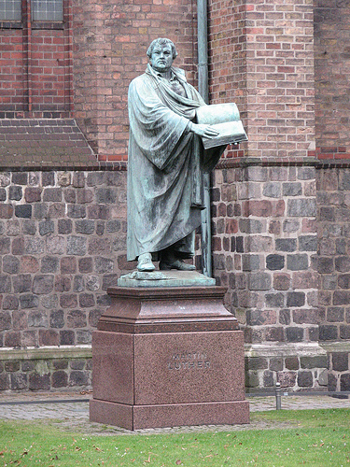
My, my this here Lutheran guy
May be famous, but he’s
dangerous
And a thorn in our side.
Them good old boys at the
Vatican cried,
Saying, “Just recant or you
will be tried!”
He said, “Here I stand, I won’t be denied!”

Slide 22
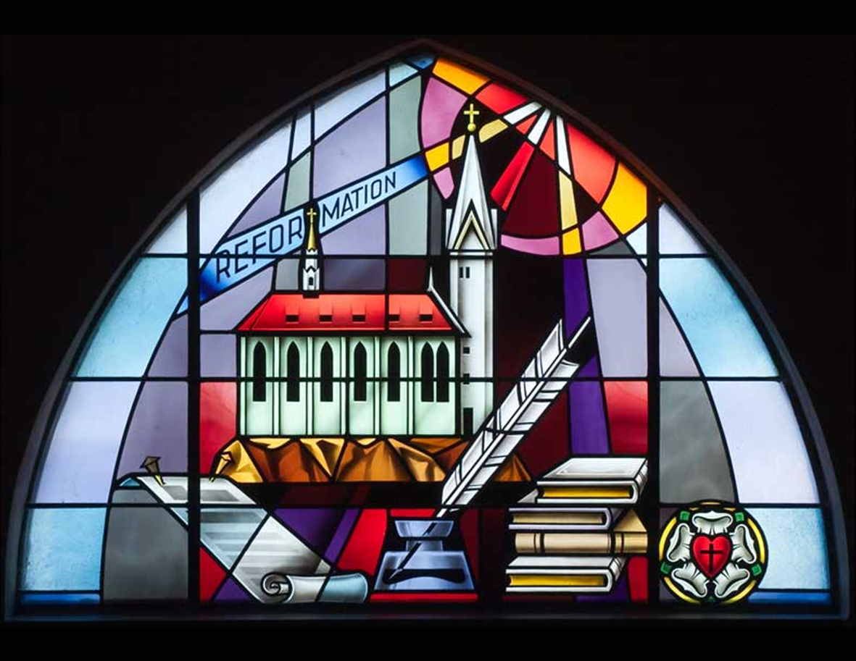
They were singing,
“My, my this here
Lutheran guy
May be famous,
but he’s dangerous
And a thorn in our
side
Them good old boys at the Vatican tried,
But he said, “Here I stand, I won’t be denied!”

